Slide 1
A comparison of the top 10 biological process (BP), cellular composition (CC) and molecular function (MF) GO terms from enrichment analysis by DAVID versus NetBAS. The p-values of enriched GO term by DAVID are converted to normal distribution z-scores and scaled to match the maximum z-score by NetBAS. Both methods indicate that GO:0060070 (canonical Wnt signaling pathway) is the mostly enriched BP term. The NetBAS gives GO:0005109 (frizzled binding) is the most enriched MF term, however, it was not predicted by DAVID, although this function is carried by the FDZ5 protein with the highest differential fitness score (NM2017). The terms GO:0003824 (catalytic activity), and GO:0016740 (transferase activity), are the top two enriched MF terms by DAVID, however, using NetBAS, they were either moderately enriched or even suppressed.

Slide 2
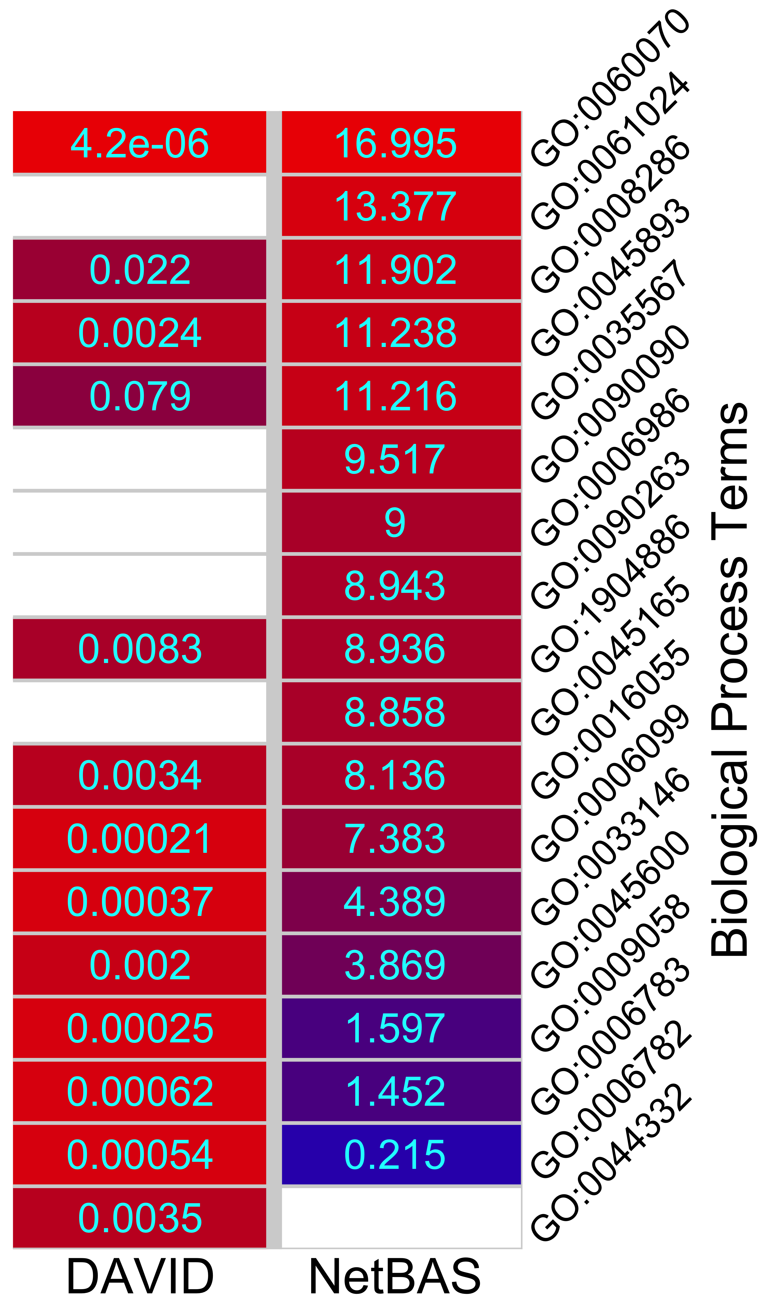
Top 10 enriched BP terms, DAVID vs NetBAS
# | DAVID |  | NetBAS
1 | GO:0060070 | canonical Wnt signaling pathway (p=4.2e-6, z=4.5) | GO:0060070 | canonical Wnt signaling pathway (z=17.0)
2 | GO:0006099 | tricarboxylic acid cycle (p=2.1e-4, z=3.5) | GO:0061024 | membrane organization (z=13.4)
3 | GO:0009058 | biosynthetic process (p=2.5e-4, z=3.5) | GO:0008286 | insulin receptor signaling pathway (z=11.9)
4 | GO:0033146 | regulation of intracellular estrogen receptor signaling pathway (p=3.7e-4, z=3.4) | GO:0035567 | non-canonical Wnt signaling pathway (z=11.2)
5 | GO:0006782 | protoporphyrinogen IX biosynthetic process (p=5.4e-4, z=3.3) | GO:0090090 | negative regulation of canonical Wnt signaling pathway (z=9.5)
6 | GO:0006783 | heme biosynthetic process (p=6.2e-4, z=3.2) | GO:0006986 | response to unfolded protein (z=9.0)
7 | GO:0045600 | positive regulation of fat cell differentiation (p=0.0020, z=2.9) | GO:0090263 | positive regulation of canonical Wnt signaling pathway (z=8.9)
8 | GO:0045893 | positive regulation of transcription, DNA-templated (p=0.0024, z=2.8) | GO:1904886 | beta-catenin destruction complex disassembly (z=8.9)
9 | GO:0016055 | Wnt signaling pathway (p=0.0034, z=2.7) | GO:0045165 | cell fate commitment (z=8.9)
10 | GO:0044332 | Wnt signaling pathway involved in dorsal/ventral axis specification (p=0.0035, z=2.7) | GO:0016241 | regulation of macroautophagy (z=8.6)

Slide 3
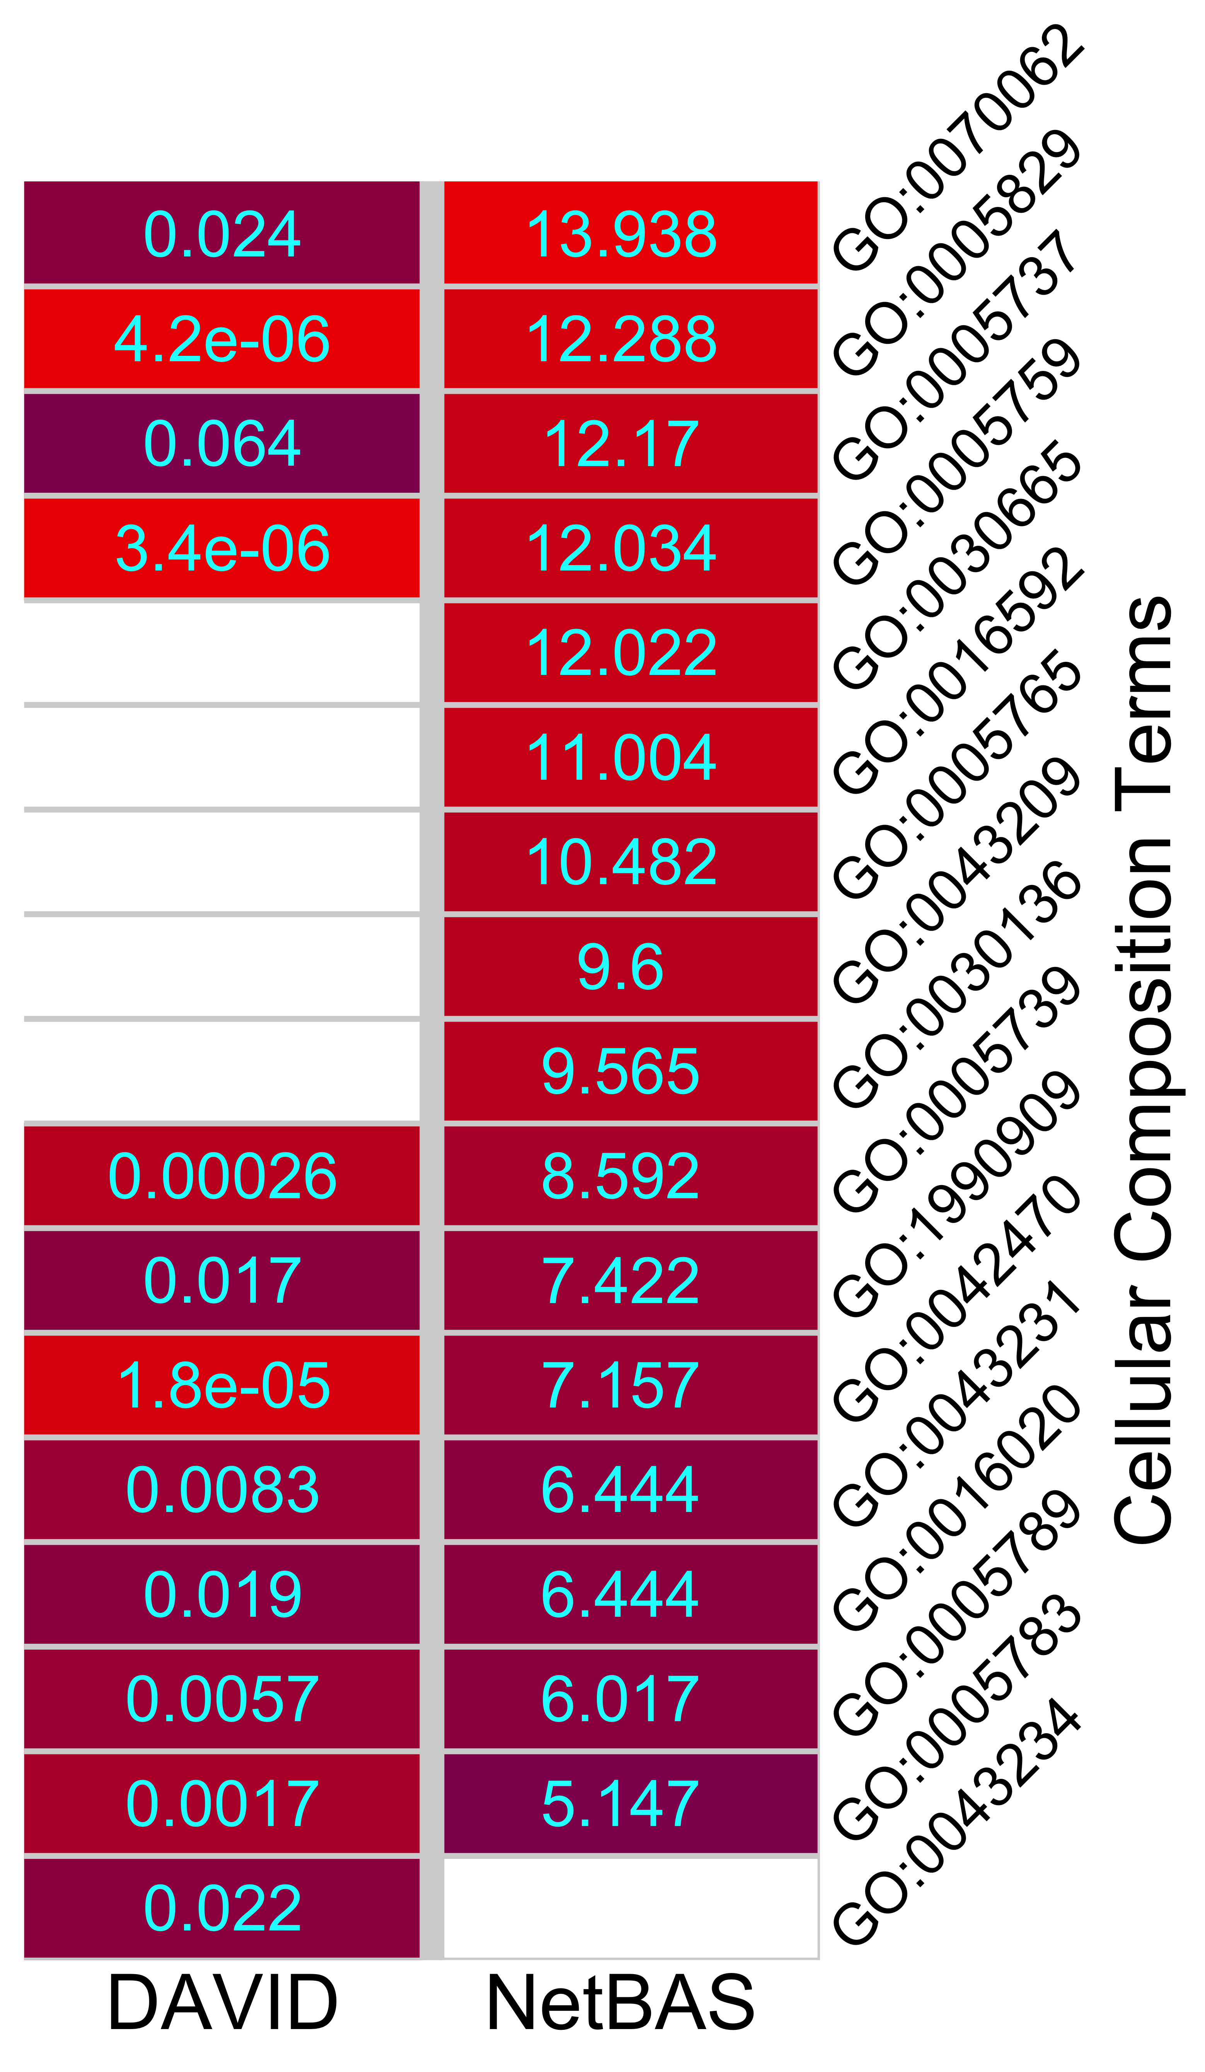
Top 10 enriched CC terms, DAVID vs NetBAS
# | DAVID |  | NetBAS
1 | GO:0005759 | mitochondrial matrix (p=3.4e-6) | GO:0070062 | extracellular exosome (z=14.0)
2 | GO:0005829 | cytosol (p=4.2e-6) | GO:0005829 | cytosol (z=12.3)
3 | GO:0042470 | melanosome (p=1.8e-5) | GO:0005759 | mitochondrial matrix (z=12.0)
4 | GO:0005739 | mitochondrion (p=2.6e-4) | GO:0030665 | clathrin-coated vesicle membrane (z=12.0)
5 | GO:0005783 | endoplasmic reticulum (p=0.0017) | GO:0005765 | lysosomal membrane (z=10.5)
6 | GO:0005789 | endoplasmic reticulum membrane (p=0.0057) | GO:0043209 | myelin sheath (z=9.6)
7 | GO:0043231 | intracellular membrane-bounded organelle (p=0.0083) | GO:0030136 | clathrin-coated vesicle (z=9.6)
8 | GO:1990909 | Wnt signalosome (p=0.017) | GO:0005739 | mitochondrion (z=8.6)
9 | GO:0016020 | membrane (p=0.019) | GO:0032991 | protein-containing complex (z=7.4)
10 | GO:0043234 | protein complex (0.022) | GO:0042470 | melanosome (z=7.157)

Slide 4
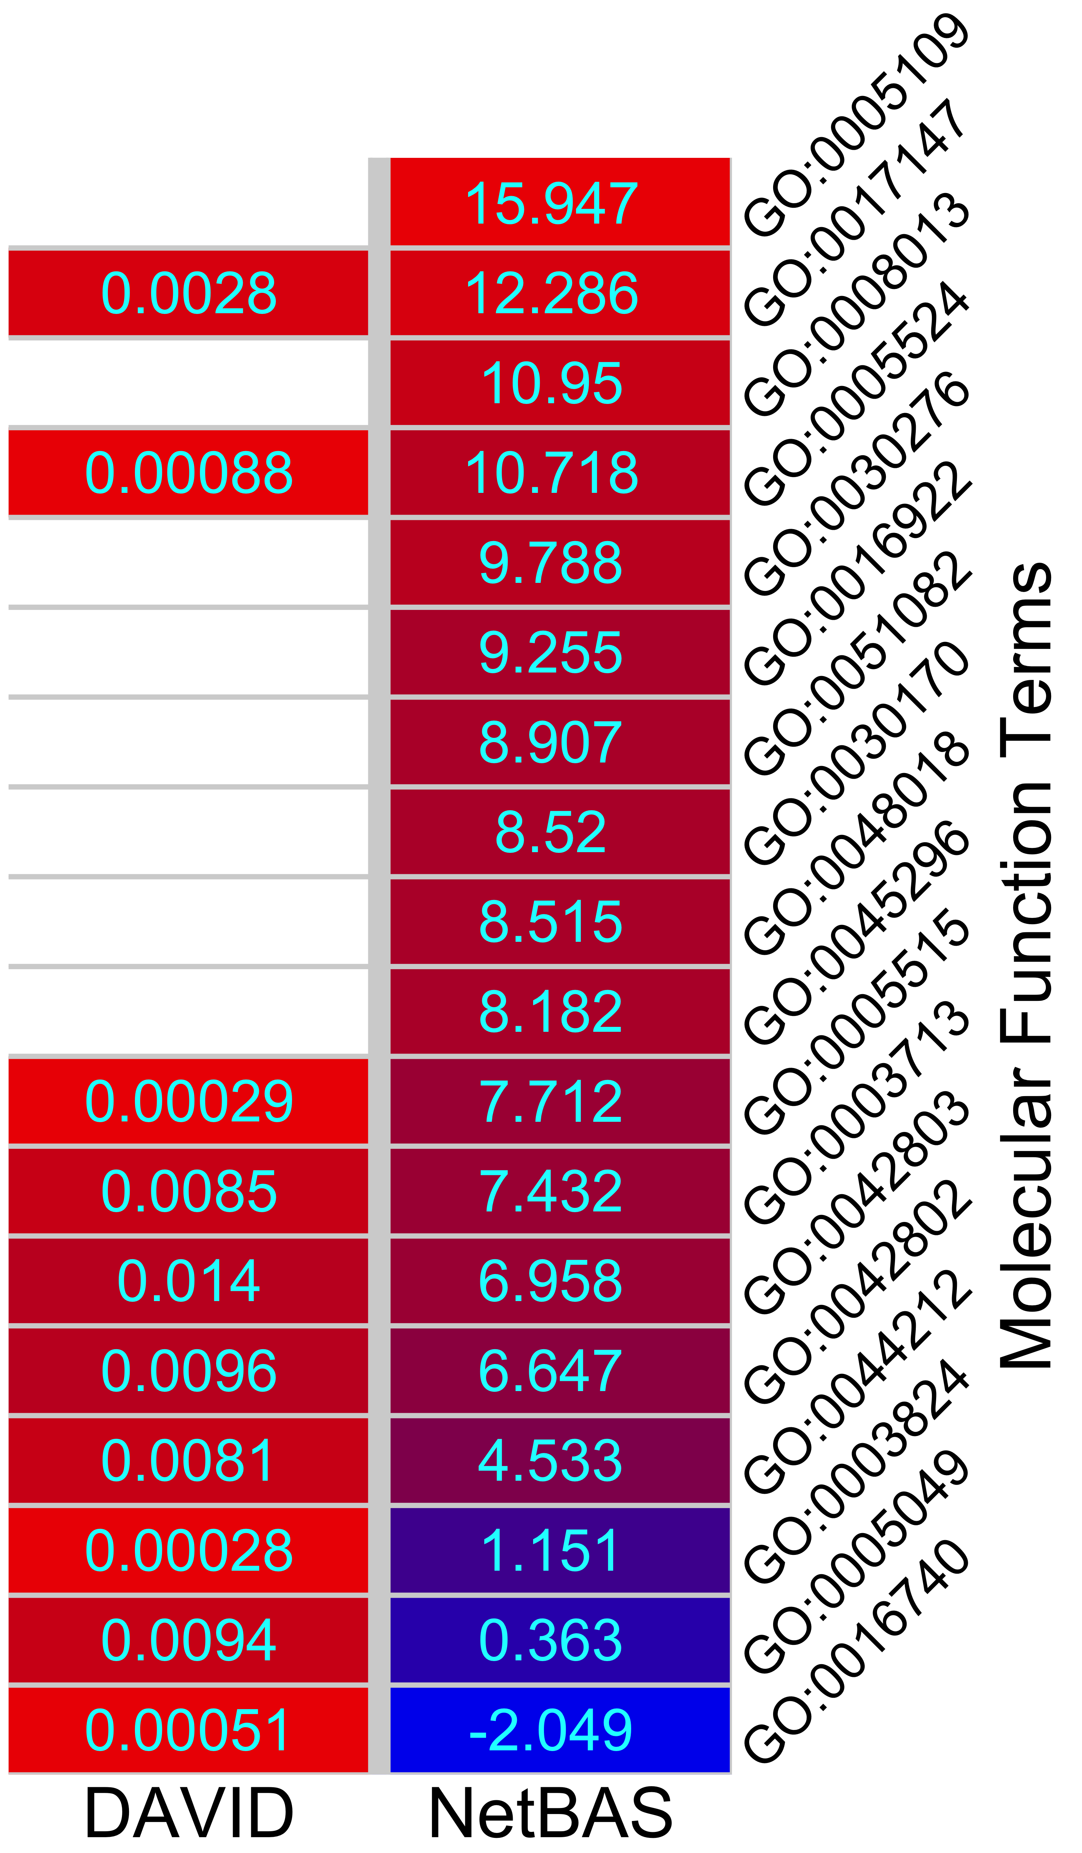
Top 10 enriched MF terms, DAVID vs NetBAS
 | DAVID |  | NetBAS
1 | GO:0003824 | catalytic activity (p=2.8e-4) | GO:0005109 | frizzled binding (z=15.9)
2 | GO:0005515 | protein binding (p=2.9e-4) | GO:0017147 | Wnt-protein binding (z=12.3)
3 | GO:0016740 | transferase activity (p=5.1e-4) | GO:0008013 | beta-catenin binding (z=11.0)
4 | GO:0005524 | ATP binding (p=8.8e-4) | GO:0005524 | ATP binding (z=10.7)
5 | GO:0017147 | Wnt-protein binding (p=0.0028) | GO:0030276 | clathrin binding (z=9.8)
6 | GO:0044212 | transcription regulatory region DNA binding (p=0.0081) | GO:0016922 | nuclear receptor binding (z=9.3)
7 | GO:0003713 | transcription coactivator activity (p=0.0085) | GO:0051082 | unfolded protein binding (z=8.9)
8 | GO:0005049 | nuclear export signal receptor activity (p=0.0095) | GO:0030170 | pyridoxal phosphate binding (z=8.5)
9 | GO:0042802 | identical protein binding (p=0.0096) | GO:0048018 | receptor ligand activity (z=8.5)
10 | GO:0042803 | protein homodimerization activity (p=0.014) | GO:0045296 | cadherin binding (z=8.2)

